Slide 1
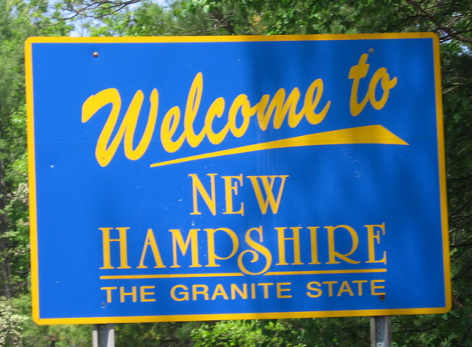
New Hampshire Traffic Stops 2014-2015
This Photo by Unknown Author is licensed under CC BY-SA
Jared, Jon, Manoj, & Jessica

Slide 2
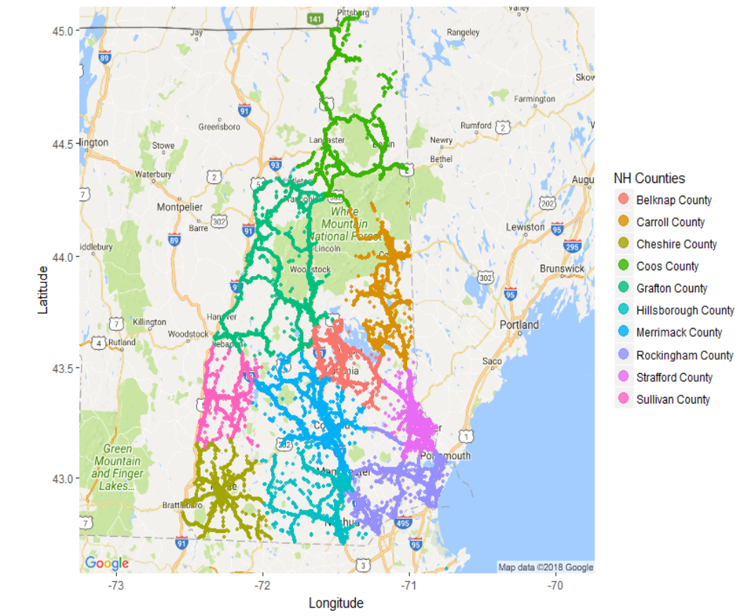

Slide 3
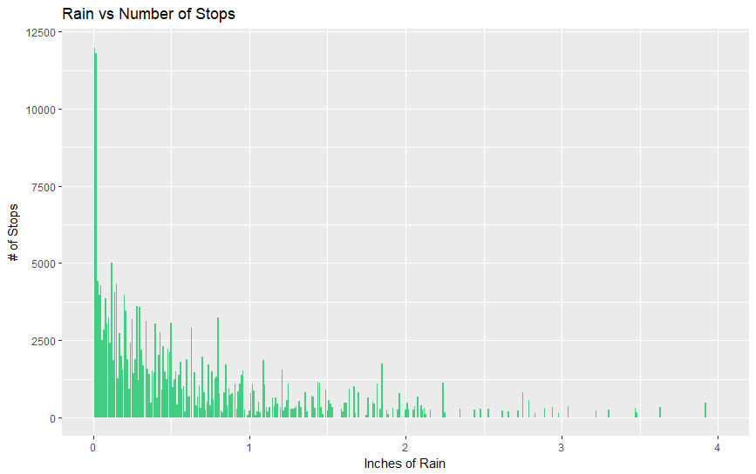

Slide 4
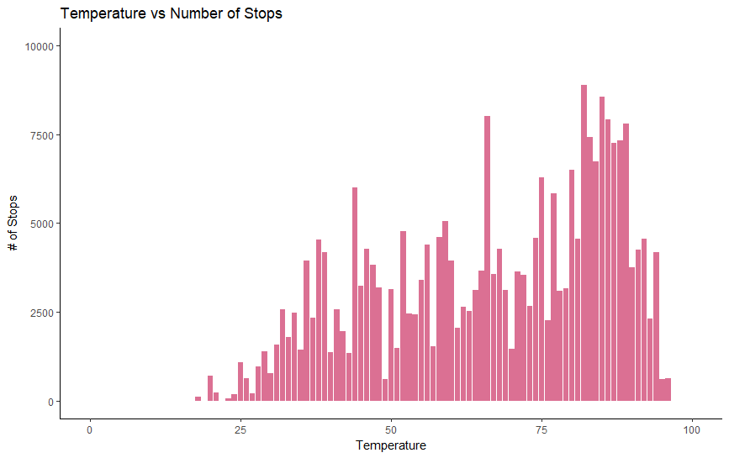

Slide 5
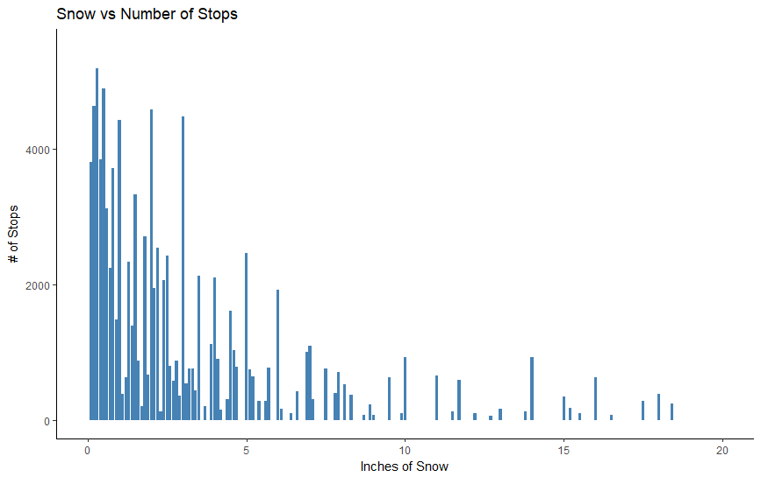

Slide 6
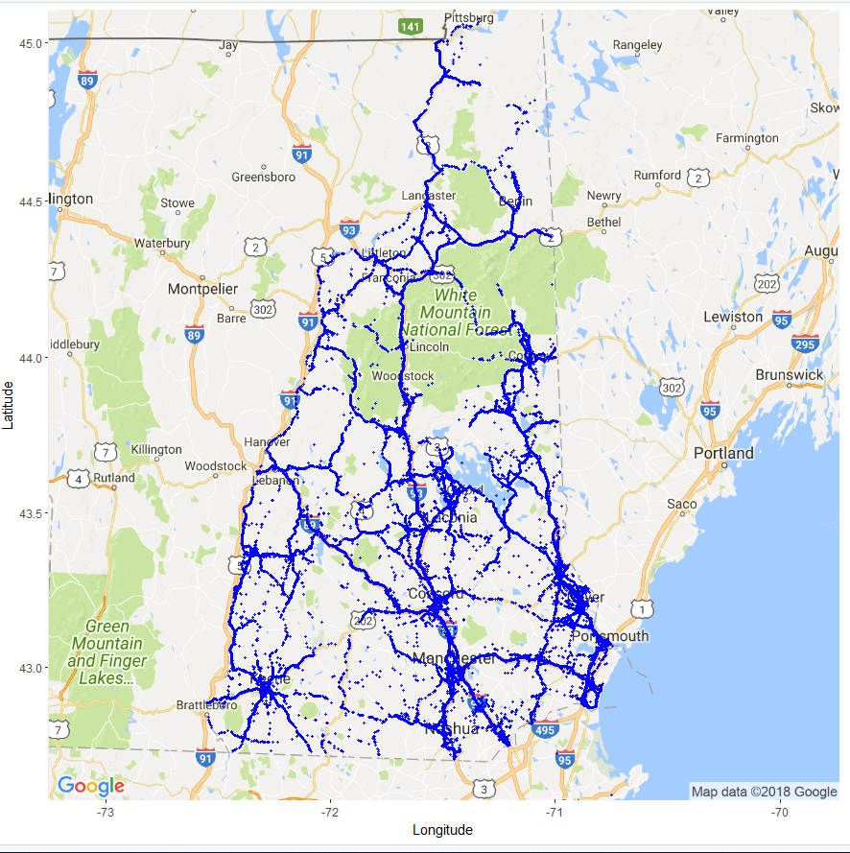
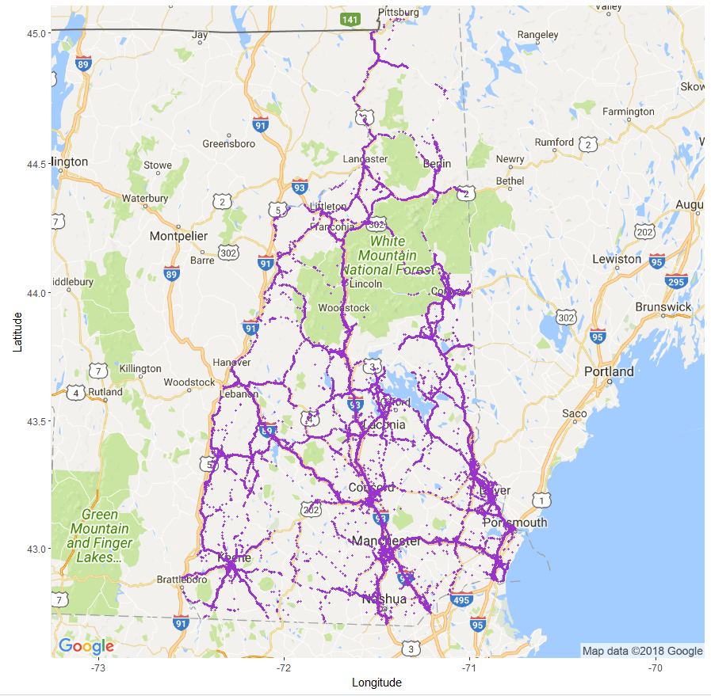
MALES ONLY
FEMALES ONLY

Slide 7
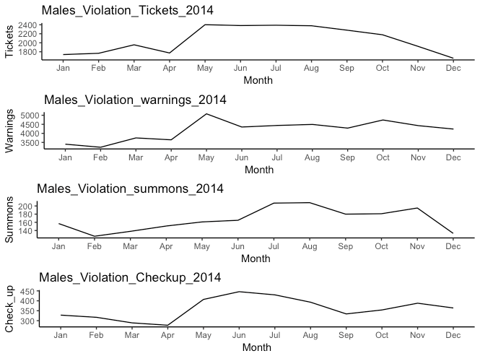
2014 Stop Outcomes for Males

Slide 8
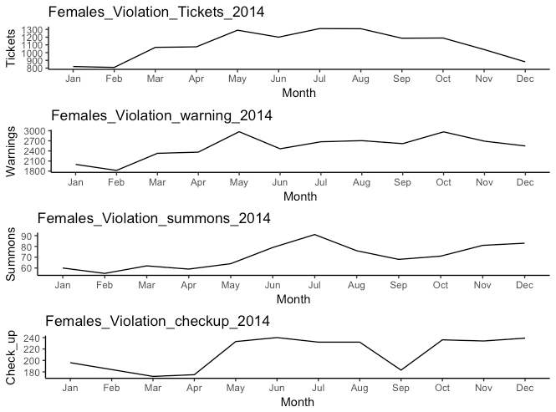
2014 Stop Outcomes Females

Slide 9
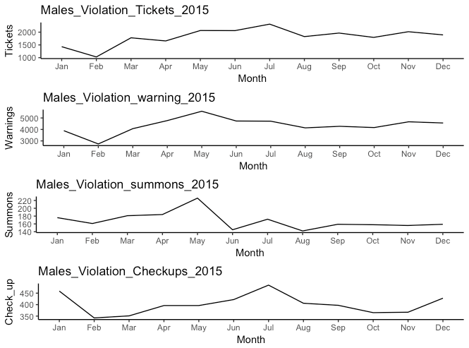
2015 Stop Outcome Males

Slide 10
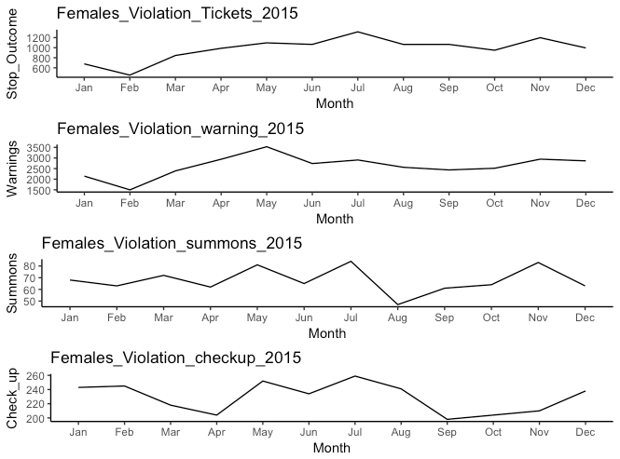
2015 Stop Outcomes Females

Slide 11
NH cops say they’re told to hit traffic ticket quotas
March 27, 2018 Portsmouth Herald
Police patrolmen’s union is again files a grievance claiming city officers are working under a quota mandate for writing traffic tickets.
Police officials have denied the allegation and during a March 21 Police Commission meeting,
Police union signed a new contract in September 2016 that included a provision mandating they receive performance evaluations.
On their performance evaluations, two officers were “negatively impacted on the allegation that the officers had not met certain established benchmarks or quotas expected by the management of the Police Department.”
The union claims police management had thus established a “de facto quota system,”

Slide 12
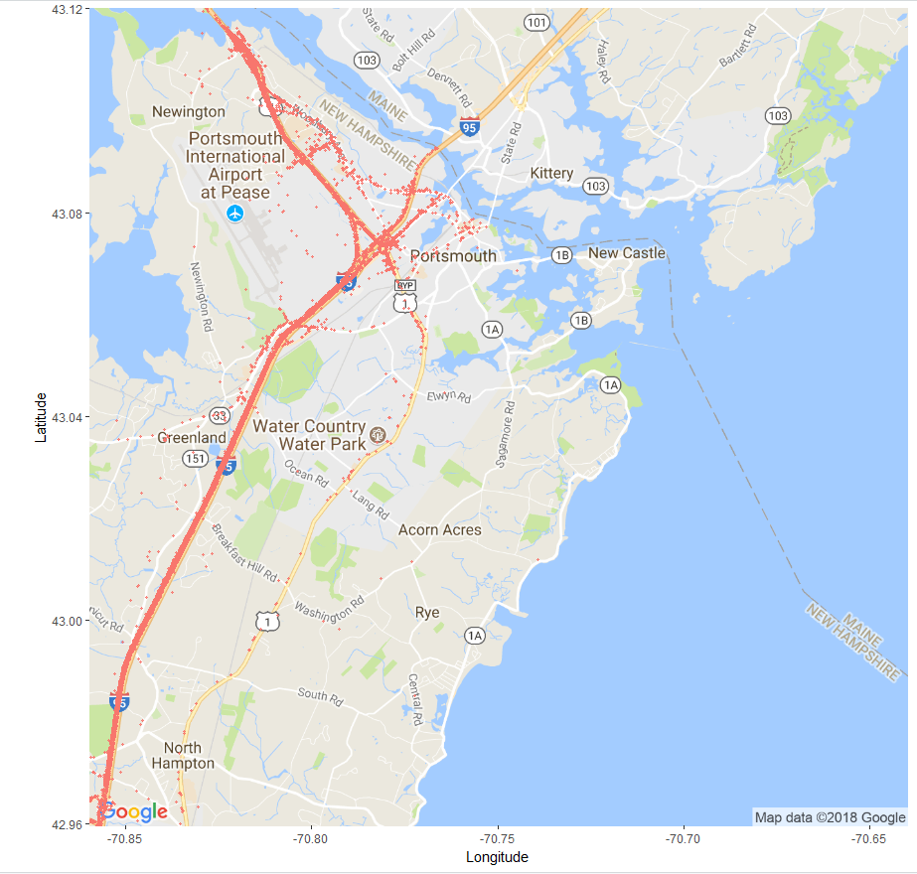
Portsmouth Area
Traffic Stops

Slide 13
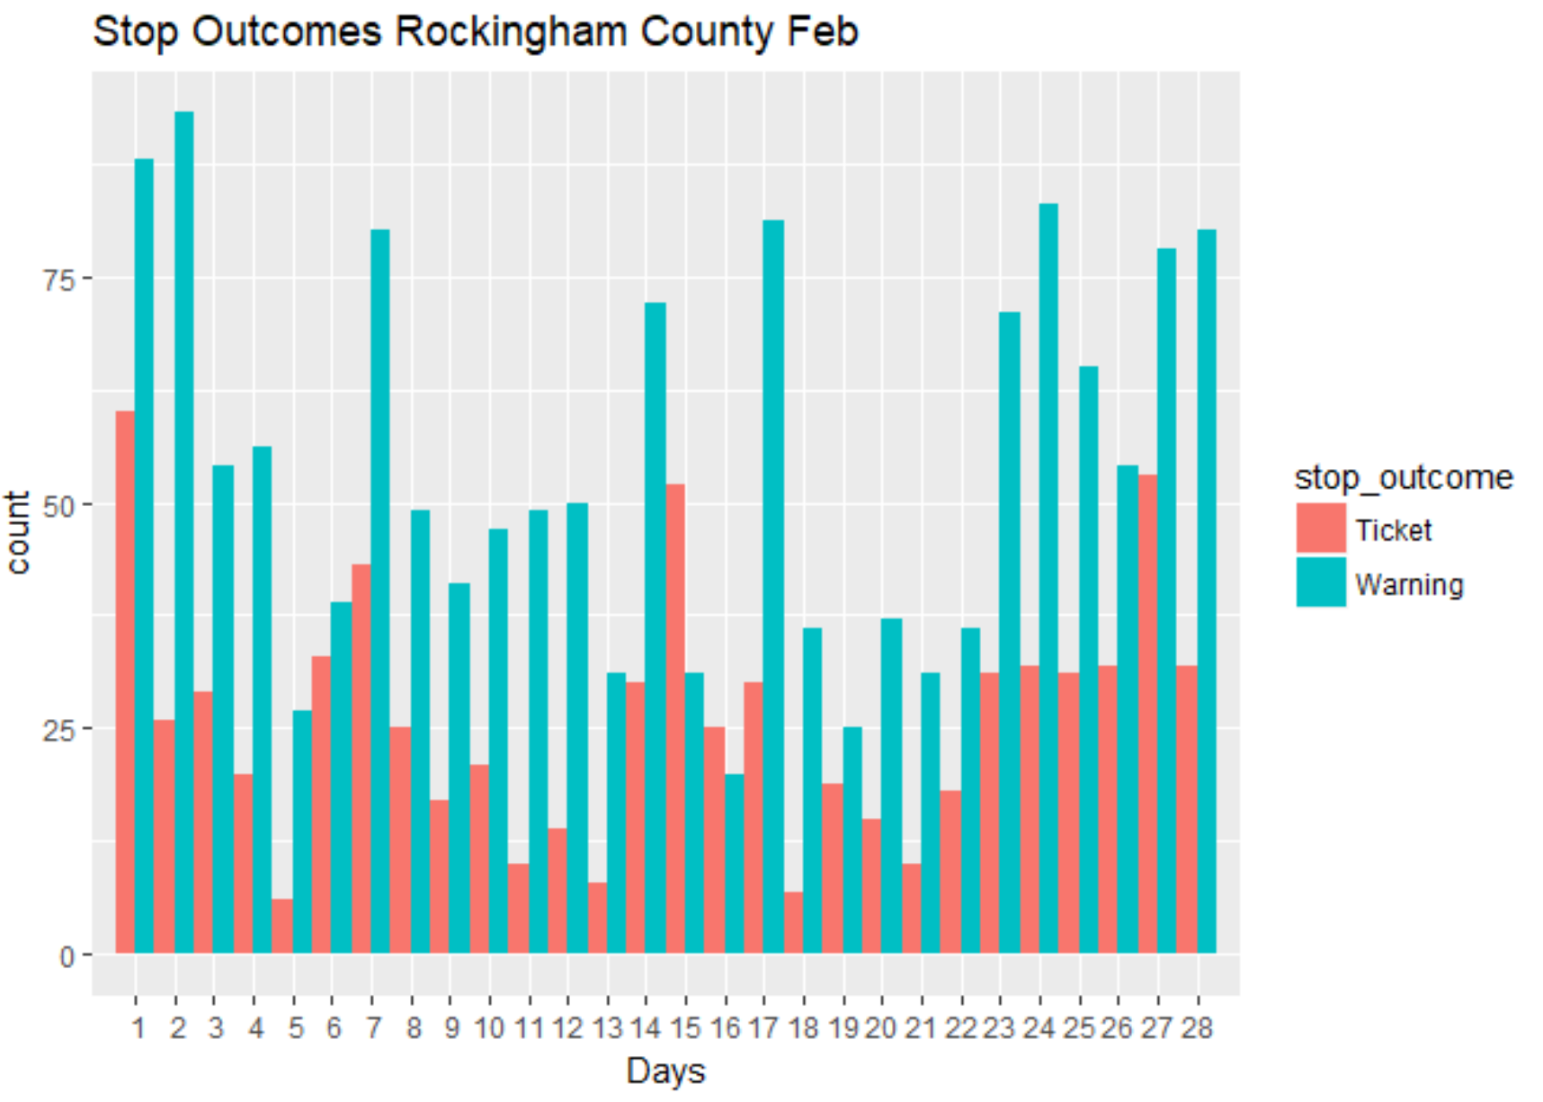

Slide 14
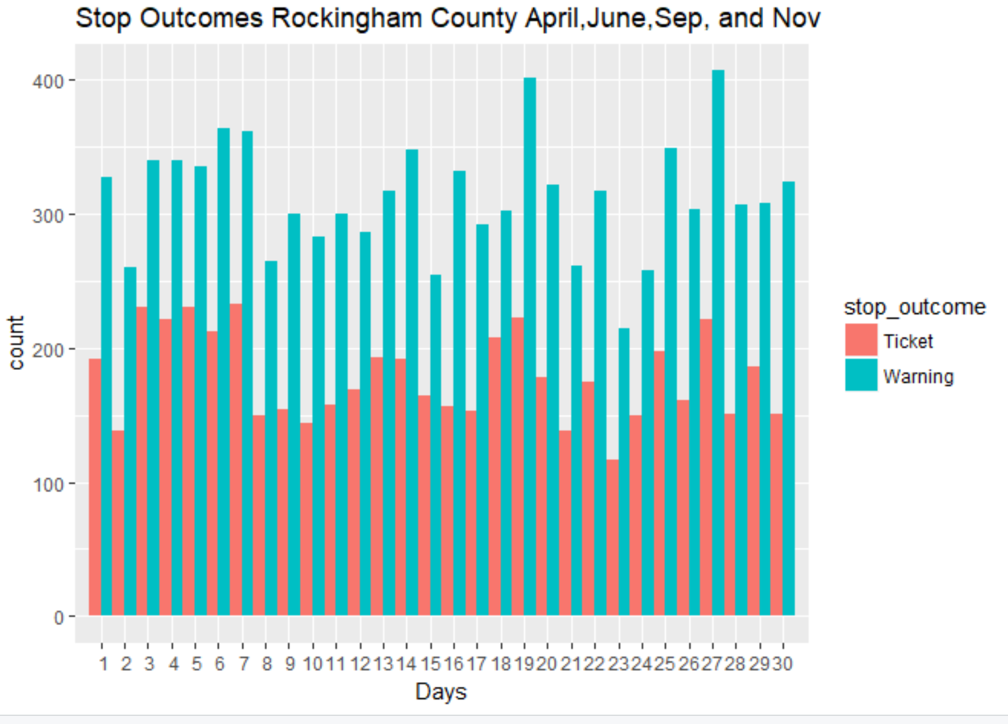

Slide 15
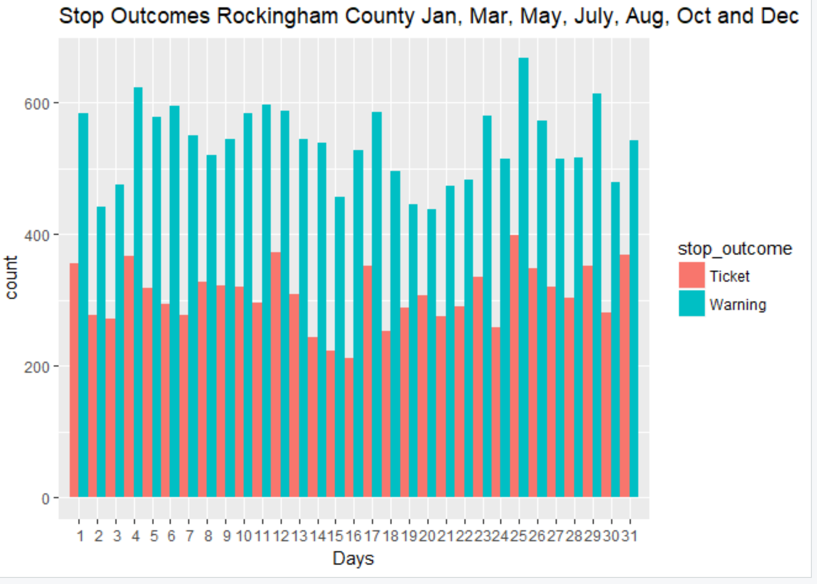

Slide 16
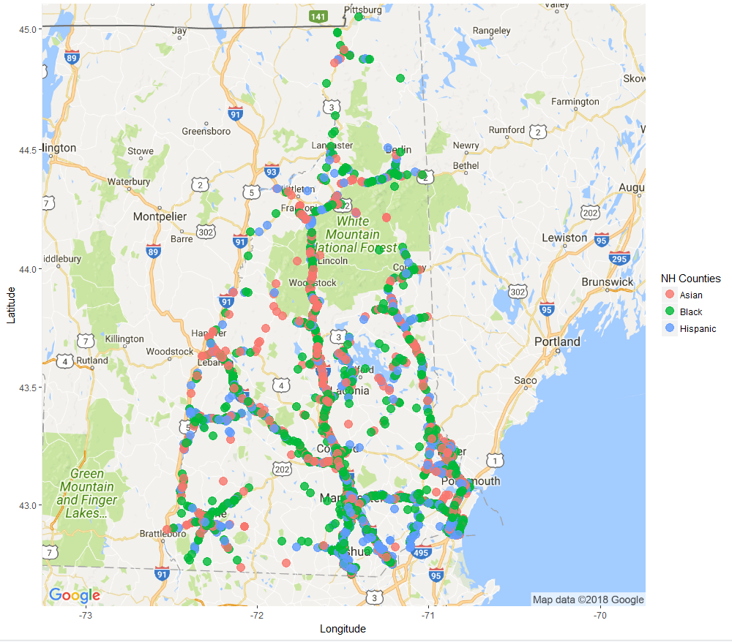
Non-White Driver
Traffic Stops

Slide 17
